Slide 1

The Advocacy Journey:
From Silence to Empowerment
Alex Bender

Slide 2
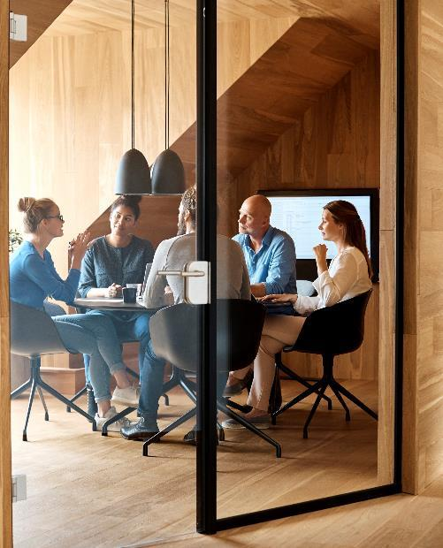



Introduction
I believe the world needs more people who advocate for those in need. Let’s build systems that encourage people to stand for what they believe in to influence others to make better and more empathic decisions.

Slide 3



Agenda
What does Advocacy Look Like?
Dynamics
Four Perspectives
Avoid Defensiveness
What’s at Risk?

Slide 4
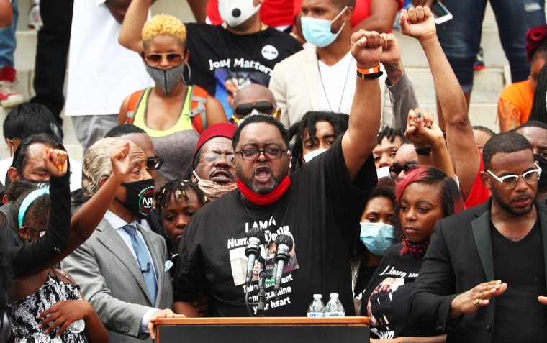
What does Advocacy look like?
Leading a Movement
https://www.nbcnews.com/news/us-news/summer-digital-protest-how-2020-became-summer-activism-both-online-n1241001

Slide 5
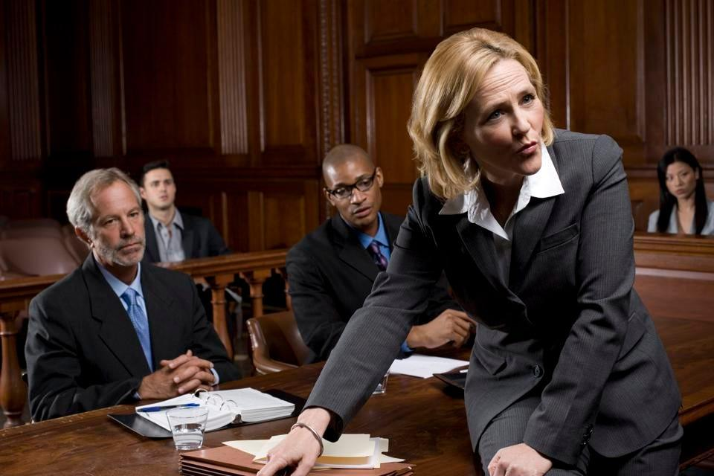
What does Advocacy look like?
Leading a Movement
Court Litigation
https://www.forbes.com/sites/kimelsesser/2018/10/01/female-lawyers-face-widespread-gender-bias-according-to-new-study/?sh=4fdee6f74b55

Slide 6

What does Advocacy look like?
Leading a Movement
Court Litigation
Conversation Around the Dinner Table
https://www.momlifetv.com/moms-of-teens/family-friends-relationships/bring-family-back-dinner-table/

Slide 7

What does Advocacy look like?
Leading a Movement
Court Litigation
Conversation Around the Dinner Table
Speaking out at a Social Gathering
https://www.istockphoto.com/photo/fairplay-before-the-game-gm889731020-246628563

Slide 8
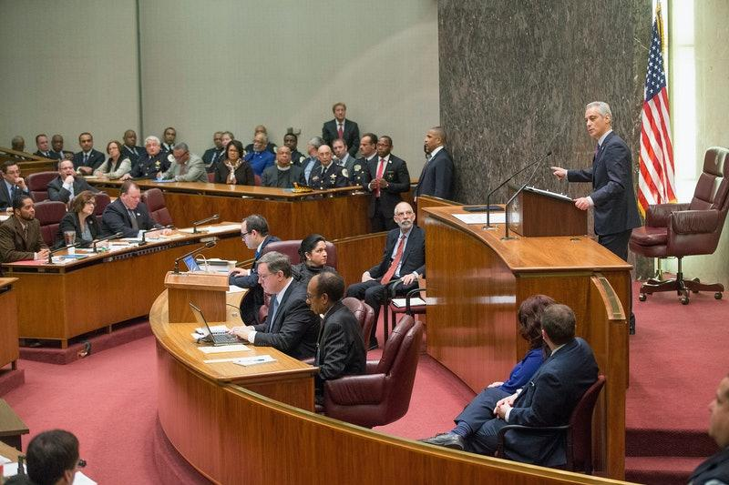
What does Advocacy look like?
Leading a Movement
Court Litigation
Conversation Around the Dinner Table
Speaking out at a Social Gathering
Political Discourse
https://www.bustle.com/articles/130400-why-i-started-attending-city-council-meetings

Slide 9
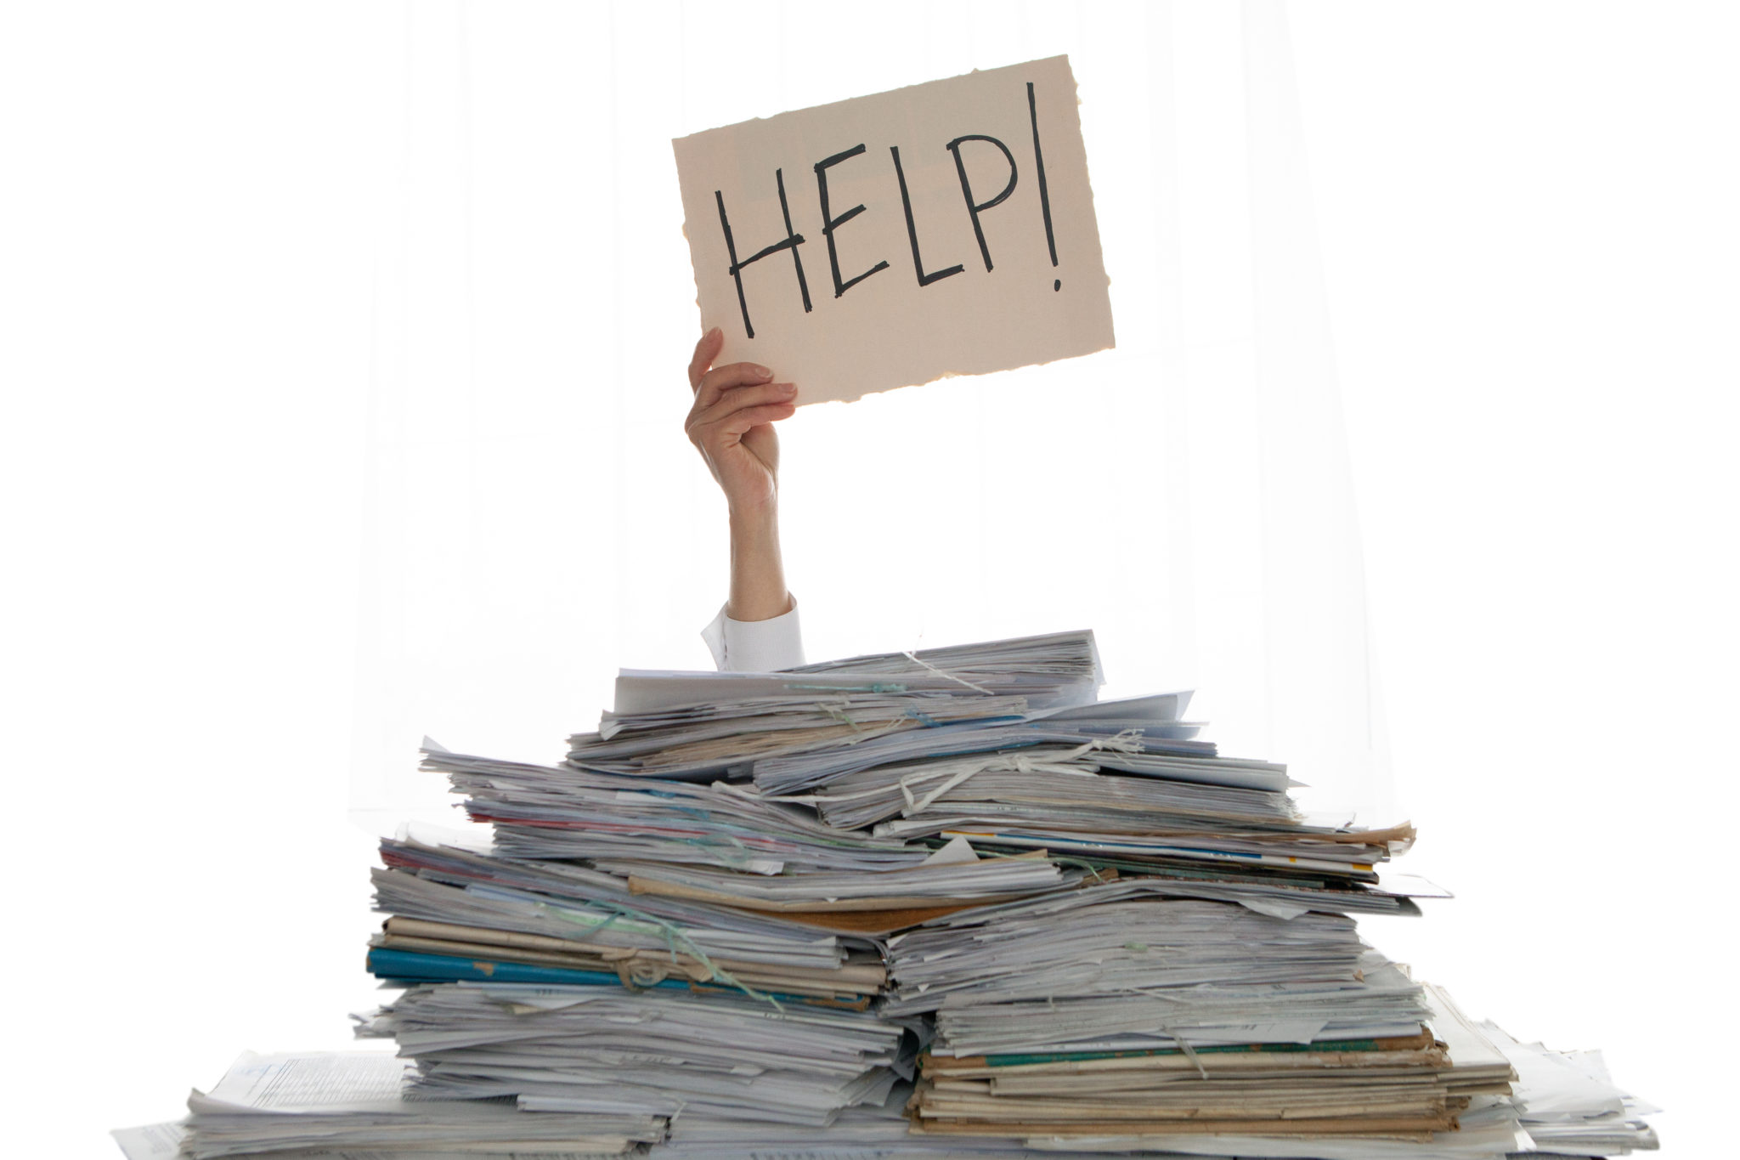
What does Advocacy look like?
Leading a Movement
Court Litigation
Conversation Around the Dinner Table
Speaking out at a Social Gathering
Political Discourse
Support and Accessibility
https://www.datacoalition.org/pra-modernization/

Slide 10
Dynamics of Advocacy
Subject of Advocacy
Empathy
Power & Influence
Advocate
Target Audience

Slide 11
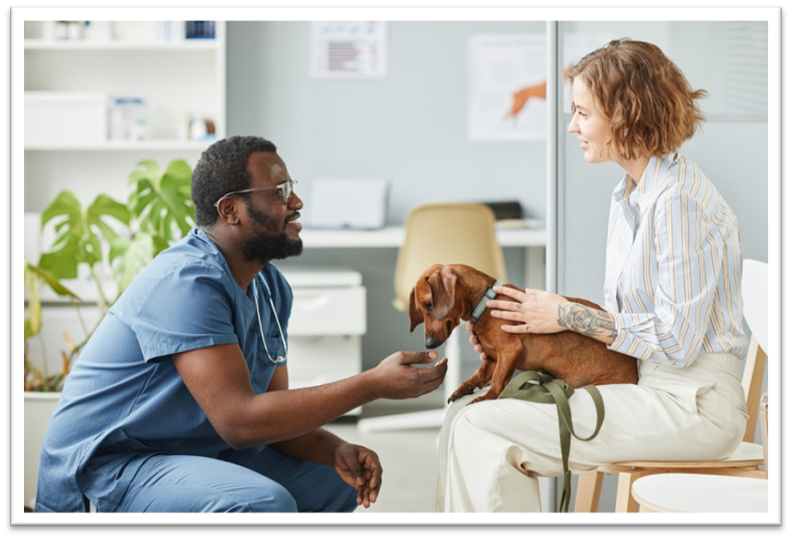
Dynamics of Advocacy
Example: Veterinarian, Patient, Client
Subject of Advocacy
Empathy
Power & Influence
Advocate
Target Audience

Slide 12
Integral Theory 4 Quadrant Model
Individual
Individual Subjective
“I”
Individual Objective
“It”
Subjective
Objective
Collective Subjective
“We”
Collective Objective
“Its”
Collective

Slide 13
I
Thoughts
Emotions
Perceptions
Sensations
Judgements
Individual Subjective
“I”
Individual Objective
“It”
Collective Subjective
“We”
Collective Objective
“Its”

Slide 14
We
Individual Subjective
“I”
Individual Objective
“It”
Collective Subjective
“We”
Collective Objective
“Its”
Community
Culture
Shared Values
Language
Relationships

Slide 15
It
Materialism
Measurable
Actions
Scientific
Data
Individual Subjective
“I”
Individual Objective
“It”
Collective Subjective
“We”
Collective Objective
“Its”

Slide 16
Its
Individual Subjective
“I”
Individual Objective
“It”
Collective Subjective
“We”
Collective Objective
“Its”
Systems
Technology
Networks
Government
Natural Environment

Slide 17
Laws & Intersections
Cultural Norms
  Presentation of Judgements
  Collective Moral Compass?
  Challenge of Dynamic Pressures
Objective Measures
  In Compliance v Out of Compliance
  Enforceable Standards of Behavior
  System of Accountability

Slide 18
Avoid Defensiveness
The “Why” Trap
  Denial
  Projection
  Rationalization
  Withdrawal

Slide 19
Counter Strategies
Using Imago Dialog
Open Dialogue
  Psychological Safety
Active Listening
  Mirroring: I heard you say - Repeat back what they said
  Is there more?
Validation
  Summarize and connect
Empathize via “I” Statements
  I feel this way
  I imagine this is what you might be going through
Common Ground
  Shared values and objectives

Slide 20
What’s at Risk?
IF YOU DO NOTHING/STAY SILENT
Current Situation Continues
Lose Employees, Friends, Members of Your Community
You Could Be Wrong

Slide 21
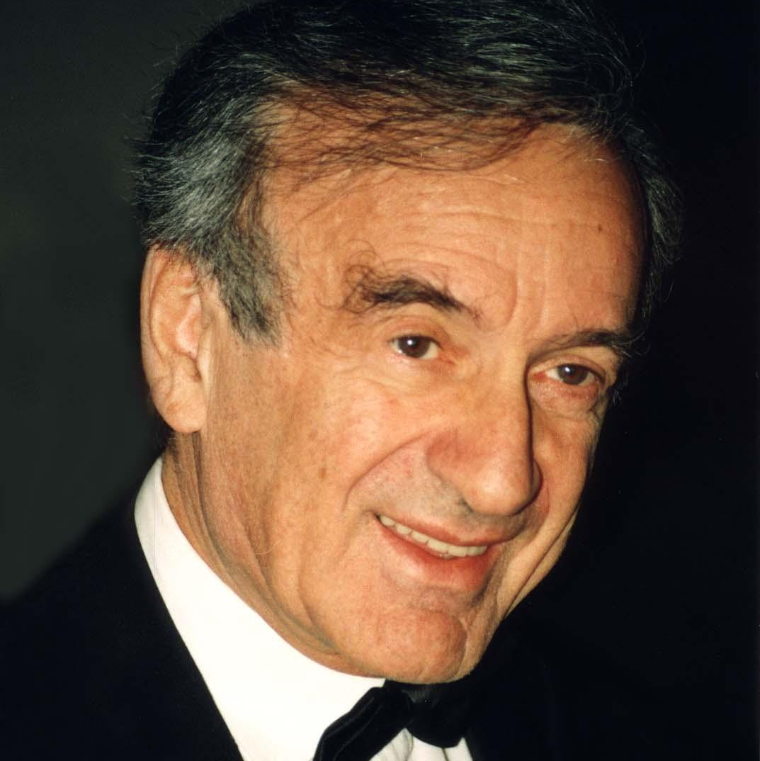
“We must always take sides. Neutrality helps the oppressor, never the victim.
Silence encourages the tormentor, never the tormented.”
Elie Wiesel

Slide 22
What’s at Risk?
IF YOU DO NOTHING/STAY SILENT
IF YOU SPEAK UP
Current Situation Continues
Lose Employees, Friends, Members of Your Community
You Could Be Wrong
Current Situation Continues
Lose Employees, Friends, Members of Your Community
You Could Be Wrong
Becoming a Target / Alienated
Possibility for Change
Make Someone’s Life Situation Better

Slide 23
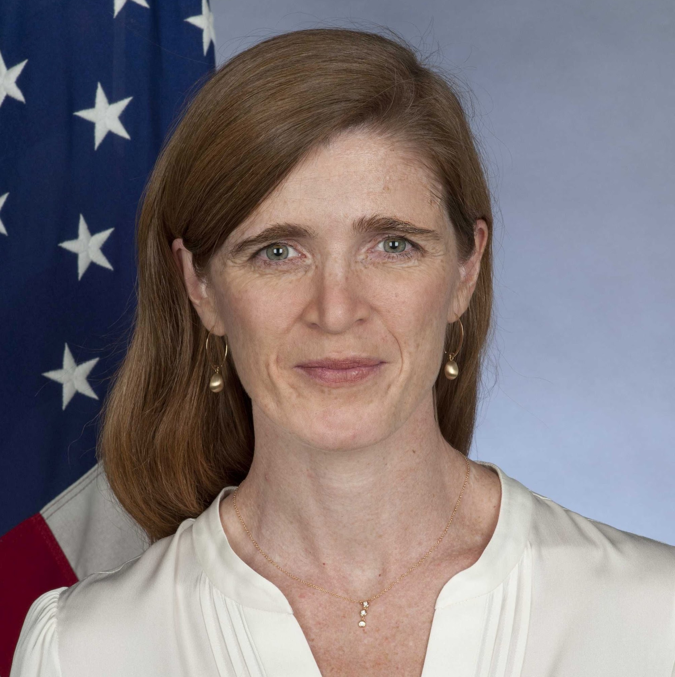
“All advocacy is, at its core, an exercise in empathy.”
Samantha Power

Slide 24

Summary
What does advocacy look like?
What can we do to make more empathic decisions ourselves?
How can we influence the people around us to do the same?

Slide 25


Thank You
Alex Bender
Alex.bender@advocacyleadership.com
http://advocacyleadership.com/

Slide 26
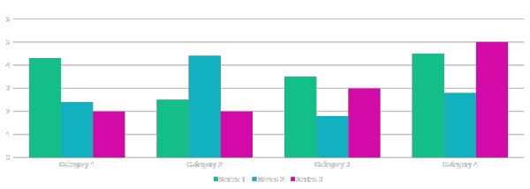
Chart

Slide 27
Table
 | Category 1 | Category 2 | Category 3 | Category 4
Item 1 | 4.5 | 2.3 | 1.7 | 5
Item 2 | 3.2 | 5.1 | 4.4 | 3
Item 3 | 2.1 | 1.7 | 2.5 | 2.8
Item 4 | 4.5 | 2.2 | 1.7 | 7

Slide 28
Timeline
To start a presentation, go to the Slide Show tab, and select From Beginning.
During your presentation, the speaker notes are visible on your monitor, but aren't visible to the audience.
If you don’t see the Notes pane or it is completely minimized, click Notes on the task bar across the bottom of the PowerPoint window.
Title
Title
Title
Title
Title
To display Presenter view, in Slide Show view, on the control bar at the bottom left select the three dots, and then Show Presenter View.
The Notes pane is a box that appears below each slide. Tap it to add notes.

Slide 29
Content 2
SUBTITLE
SUBTITLE
SUBTITLE
Add text, images, art, and videos.
Add transitions, animations, and motion.
Save to OneDrive, to get to your presentations from your computer, tablet, or phone.
Open the Design Ideas pane for instant slide makeovers.
When we have design ideas, we’ll show them to you right there.
Add text, images, art, and videos.
Add transitions, animations, and motion.
Save to OneDrive, to get to your presentations from your computer, tablet, or phone.
Open the Design Ideas pane for instant slide makeovers.
When we have design ideas, we’ll show them to you right there.
Add text, images, art, and videos.
Add transitions, animations, and motion.
Save to OneDrive, to get to your presentations from your computer, tablet, or phone.
Open the Design Ideas pane for instant slide makeovers.
When we have design ideas, we’ll show them to you right there.

Slide 30

Topic one
Subtitle

