Slide 1
Connecting Through Differences:
A Guide to Better Communication
Alex Bender
Notes:
"Connecting Through Differences: A Guide to Better Communication"
Description: Discover how to navigate conversations with people who have different viewpoints. This session will help you understand how our own biases, whether objective or subjective, singular or pluralistic, influence our communication and offer strategies to improve connections.

Slide 2
Break the Ice
Know your meme…

Slide 3
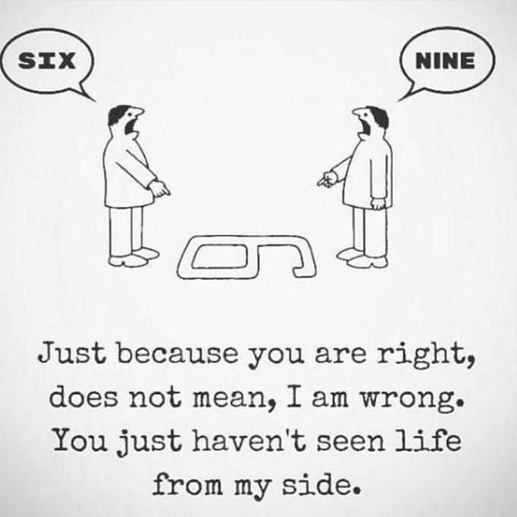

Slide 4
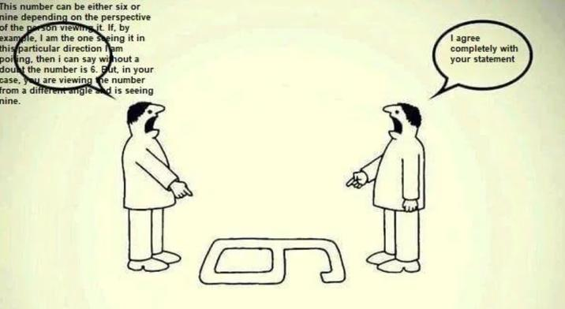

Slide 5
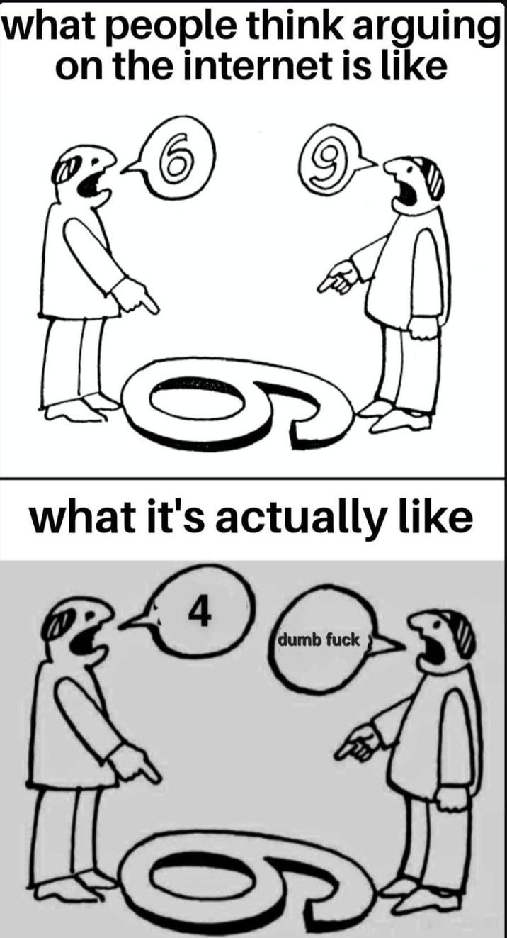

Slide 6
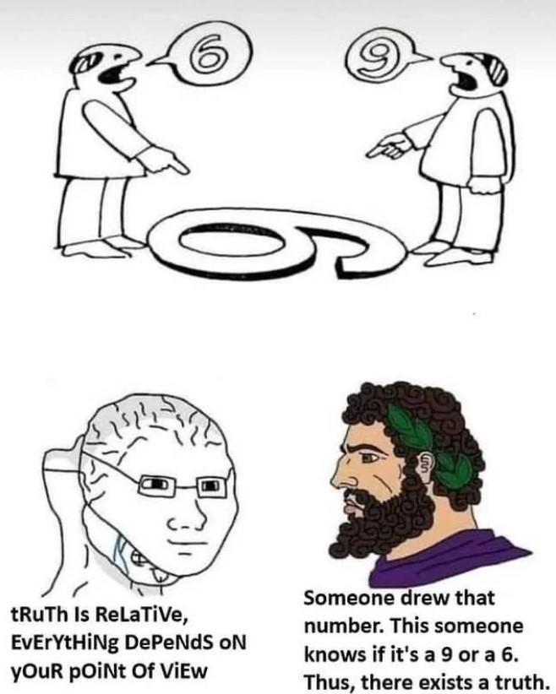

Slide 7
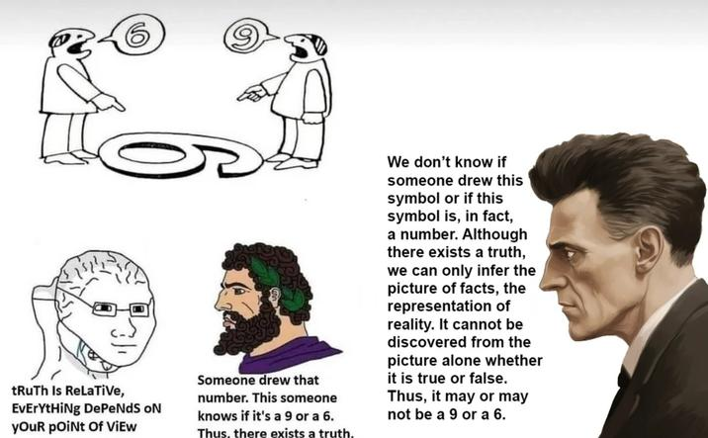

Slide 8
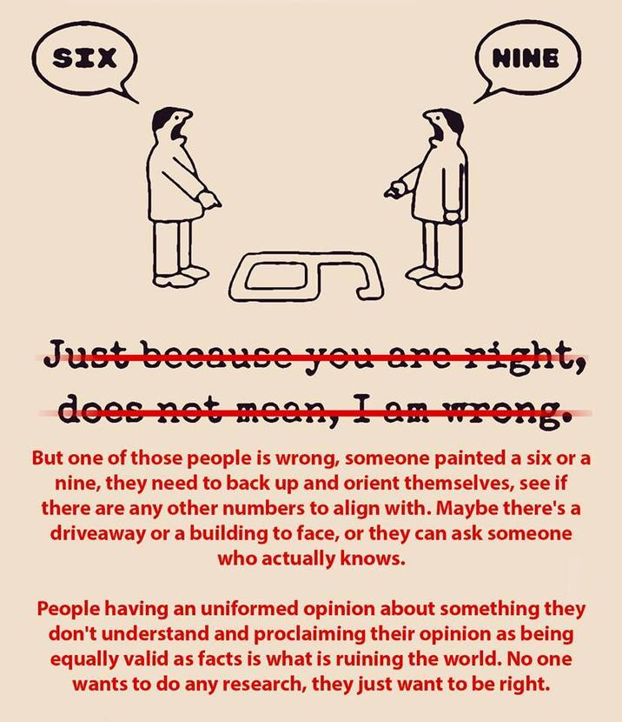

Slide 9
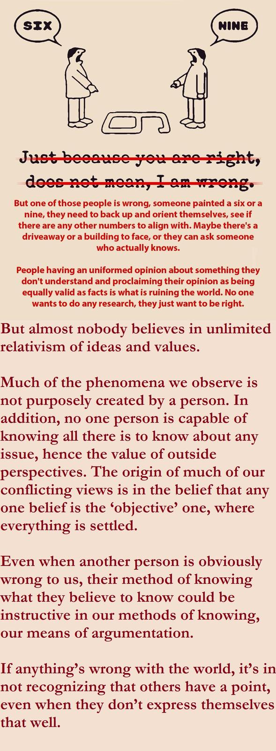

Slide 10
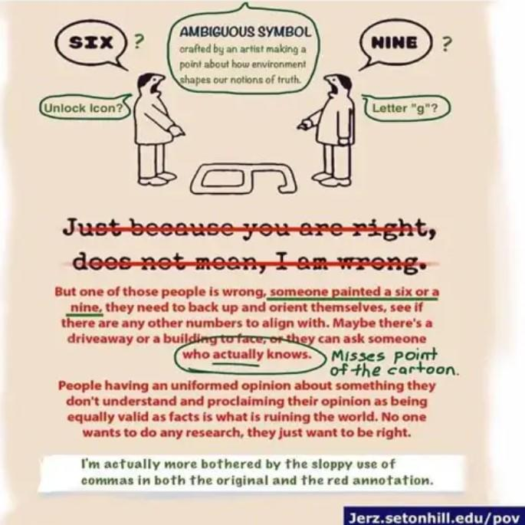

Slide 11
Perspectives
First Person
Second Person
Third Person
Singular vs. Plural
Internal vs. External
Fourth Person
Fifth Person
Notes:
Fourth-person point of view is a narrative technique that tells a story through a group of characters narrating as one. The narrator of the story uses the pronouns “we” or “us.” This point of view style is particularly popular in poetry and short fiction with a social message, using a single narrative voice to represent a larger collective.
https://www.scribophile.com/academy/what-is-fourth-person-point-of-view
Another way to think about the differences between 3rd and 4th person perspective –
3rd person is also referred to a 3rd person limited or 3rd person singular
4th person can be considered 3th person omniscient or 3rd person pluralistic
From a writing perspective.
5th person perspective gets a bit out there, and there’s not really a language tool to get deeper into it.
How do we abstract out from a 3rd person omniscient or 3rd person pluralistic view?
Fourth-Person Perspective
Just like the transition of abstracting “me” to “you” and “you” to “he/she/them” the next level abstraction must rely on the tools of our language to convey the idea. As an example, presented here: https://prowritingaid.com/point-of-view they use the idea of a collective perspective. In group therapy, it might be considering the container of the group that exists regardless of the individuals present, but the sum of the individuals creates the container. At work, you might have a team, but the idea of the team spread across the larger organization is the key. Another way to think about it could be the perspective of the idea or construct that isn’t tied to a specific person or group.
Example: Going from a single team to a set of teams and how there are common elements.
How does fourth-person perspective help us as advocates and leaders? Context matters. Fourth-person perspective gives us context to the ideas around the groups and teams and organizations we are involved with. We start integrating the multitudes of perspectives that can happen all at once. As bridge-builders we speak across the power divide and help guide the decision-making to help not just the selfish or individualistic goals, but we can walk the layers of abstraction and guide those with power to see at every view. Help those with power to go beyond looking in the mirror or just the “us” group and look at the full breadth of the impact of their choices and use the tools appropriate for each level to speak to the biases of those who need to make those decisions and leverage as a guiding hand.

Slide 12
Perspective Quadrants
From Ken Wilbur’s “Integral Theory”

Slide 13
Integral Theory Quadrant Model
Individual
Individual Subjective
“I”
Individual Objective
“It”
Collective Subjective
“We”
Collective Objective
“Its”
Subjective
Objective
Collective
Notes:
How do we address personal bias?

Slide 14
The “I” Perspective
Internal Individual Subjective
“I”
Individual Objective
“It”
Collective Subjective
“We”
Collective Objective
“Its”
Thoughts
Emotions
Perceptions
Sensations
Judgements
Notes:
Classical 1st perspective

Slide 15
The “You” Perspective
External Individual Subjective
“You”
Individual Objective
“It”
Collective Subjective
“We”
Collective Objective
“Its”
Projected
  Thoughts
  Emotions
  Perceptions
  Sensations
  Judgements
Notes:
Classical 2nd person perspective

Slide 16
The “We” Perspective
Individual Subjective
“I”
Individual Objective
“It”
Internal Collective Subjective
“We”
Collective Objective
“Its”
Community
Culture
Shared Values
Language
Relationships

Slide 17
The “They” Perspective
Individual Subjective
“I”
Individual Objective
“It”
External Collective Subjective
“They”
Collective Objective
“Its”
Projected
  Community
  Culture
  Shared Values
  Language
  Relationships

Slide 18
The “IT” Perspective
Individual Subjective
“I”
Individual Objective
“It”
Collective Subjective
“We”
Collective Objective
“Its”
Materialism
Measurable
Actions
Scientific
Data

Slide 19
The “ITS” Perspective
Individual Subjective
“I”
Individual Objective
“It”
Collective Subjective
“We”
Collective Objective
“Its”
Systems
Technology
Networks
Government
Natural Environment
Notes:
What scale does the individual become part of a larger whole
Ship of Theseus Idea.

Slide 20
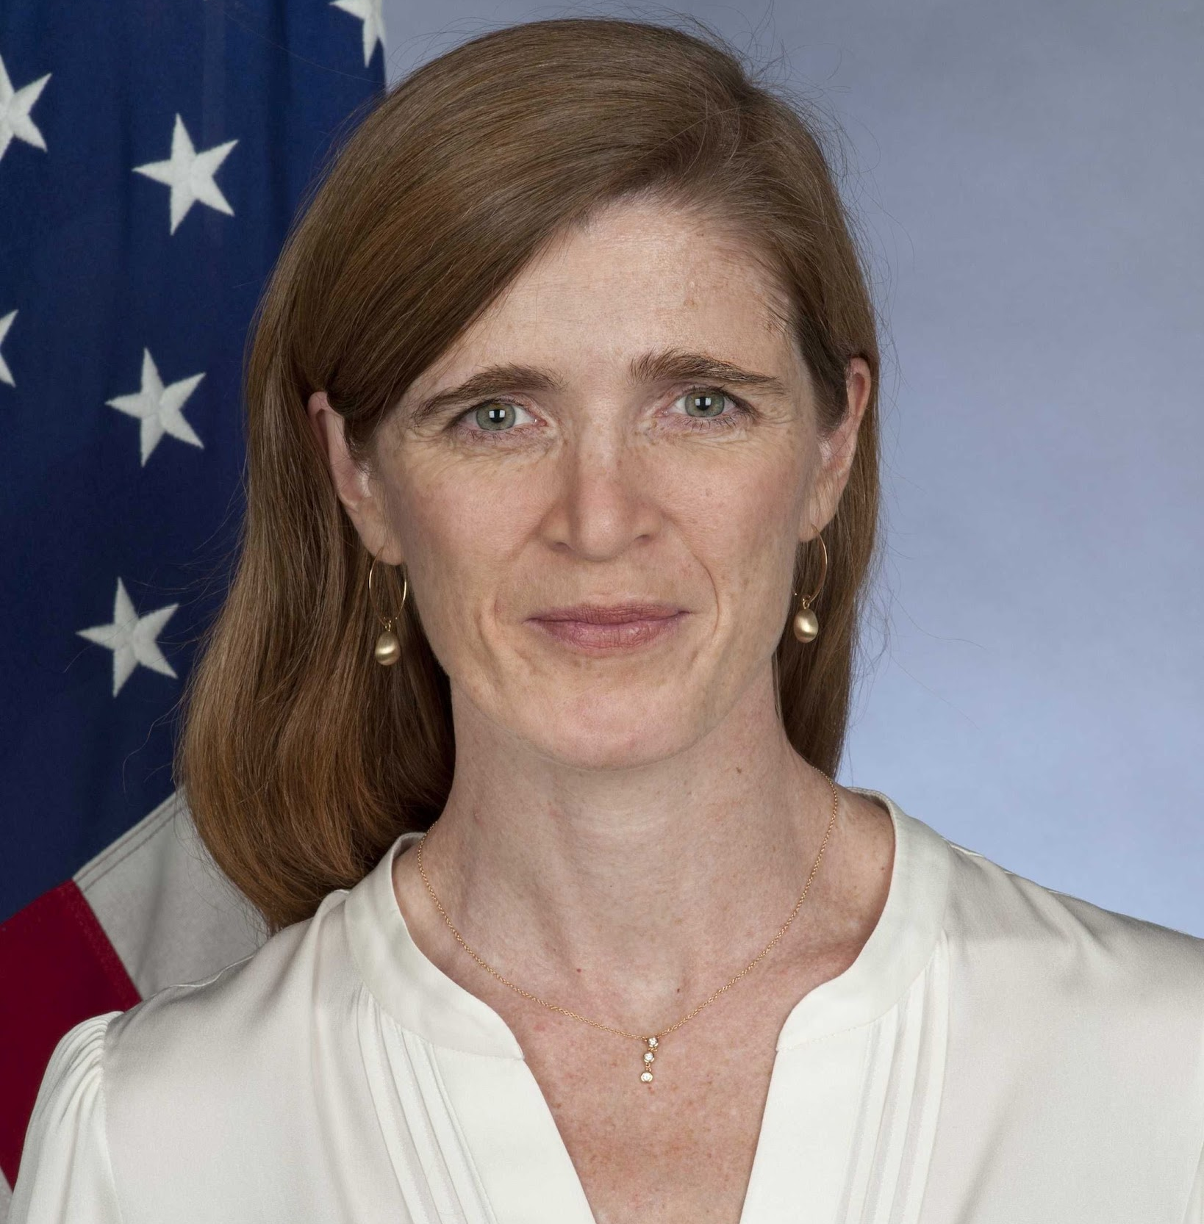
“All advocacy is,
at its core,
an exercise in empathy.”
Samantha Power

Slide 21

California Prop 8
Notes:
In the early 2000s, advocates for marriage equality in California were driven by a personal sense of justice and equality (Individual/Internal). They gathered robust data on the social and economic benefits of legalizing gay marriage (Individual/External).
This research fueled community campaigns that aimed to change the cultural conversation around same-sex marriage (Collective/Internal). Over time, these shifts in public opinion were reflected in changes in social norms, contributing to the initial legalization of gay marriage in 2008. However, this was immediately followed by Proposition 8, a voter-approved ban on same-sex marriage.
Even in defeat, the collective voice grew louder, eventually paving the way for the U.S. Supreme Court to nullify Prop 8 in 2013, effectively reinstating marriage equality in California (Collective/External).
By employing a multi-faceted, integral approach, advocates for marriage equality in California were able to change not just laws but hearts and minds, demonstrating the power of holistic advocacy.

Slide 22
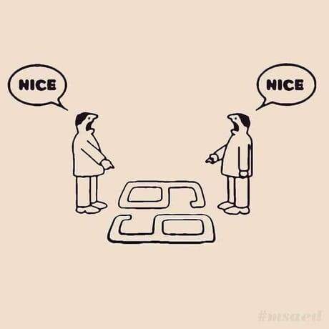

Slide 23
Thank you!
Alex Bender
alex.bender@advocacyleadership.com

