Slide 1
Breaking Barriers:
Overcoming Psychological Hurdles in Advocacy
Alex Bender
Notes:
Breaking Barriers: Overcoming Psychological Hurdles in Advocacy – Alex
Addressing defensiveness and other barriers in communication for successful advocacy. Strategies for overcoming communication challenges, including Imago Dialog and value connections.
“Sometimes, it feels like we're expected to be mind readers. The other person is thinking, ‘You should just know why I’m upset,’ while we’re over here, thinking, ‘If I could read minds, I’d probably be playing the lottery instead of trying to have this conversation!’"
This plays on the unrealistic expectations we have during communication and leads smoothly into the idea that effective advocacy is about breaking through those expectations with real strategies.

Slide 2

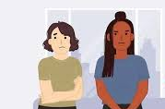
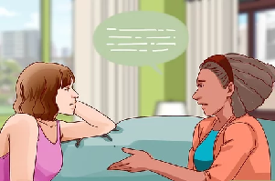

Clash to Connection

Slide 3
Dynamics of Advocacy
Subject of Advocacy
Empathy
Power & Influence
Advocate
Target Audience

Slide 4

Dynamics of Advocacy
Example: Veterinarian, Patient, Client
Subject of Advocacy
Empathy
Power & Influence
Advocate
Target Audience

Slide 5
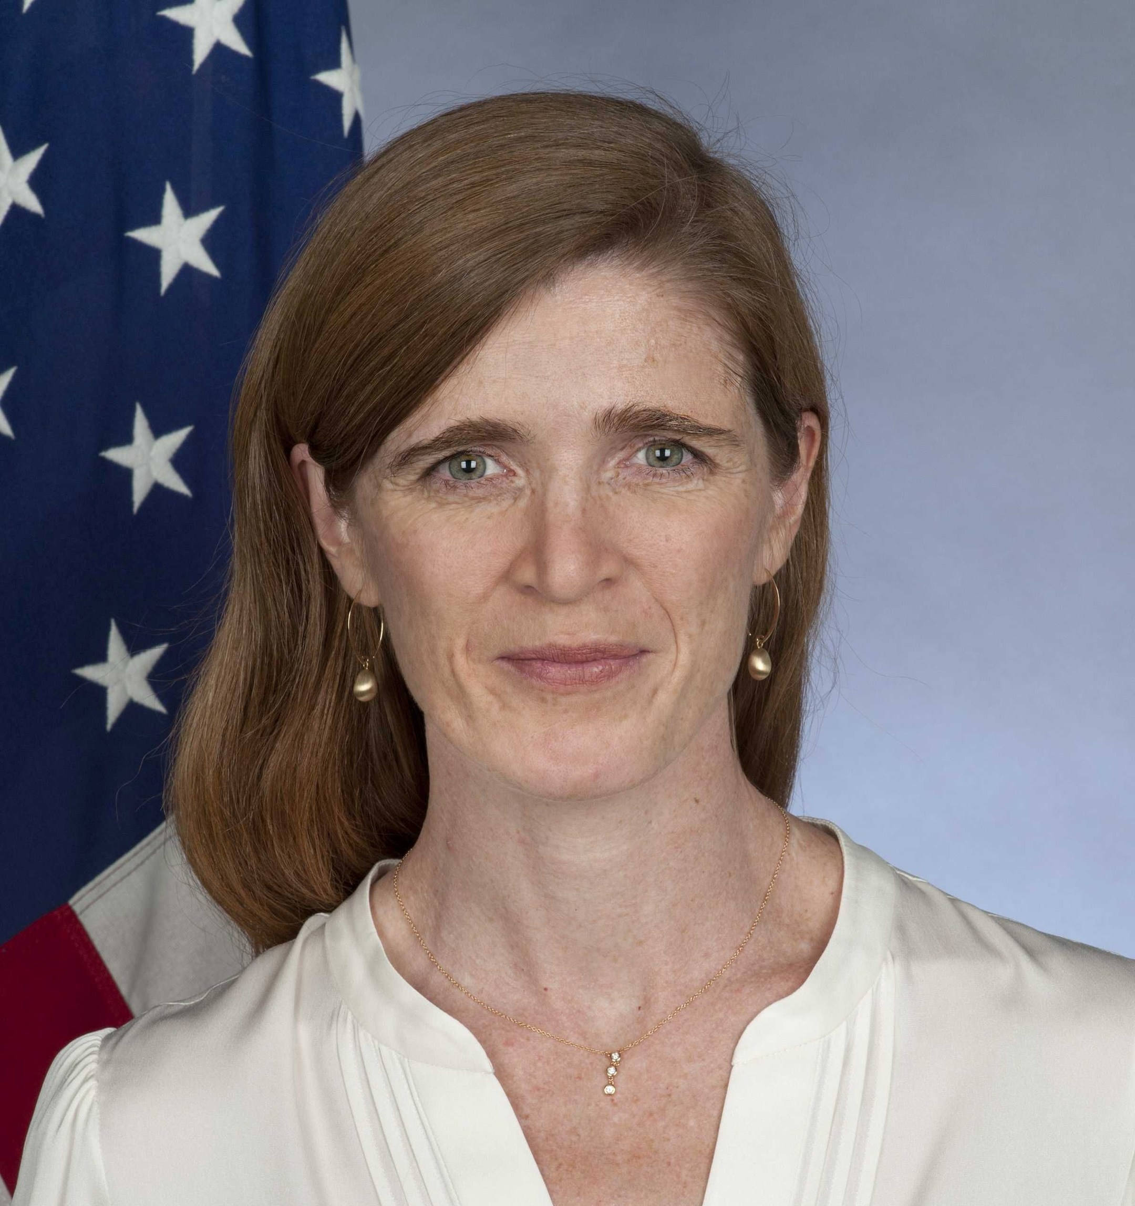
“All advocacy is, at its core, an exercise in empathy.”
Samantha Power
Administrator of the U.S. Agency for International Development (USAID)

Slide 6
Strategies
Don’t ask “Why”
Active Listening
Validation
Empathize
Find Common Ground

Slide 7

Shining a light at Shadow
The “Why” Trap
When I ask “why” …
  Did you do that?
  Do you think/feel that way?
  Did you go that way?
Implicit judgement

Slide 8
Shining a light at Shadow
The “Why” Trap
The Response:
  Hide
  Repress
  Deny
  Project
  Rationalize
  Withdraw
  Defend

Slide 9
Shining a light at Shadow
The “Why” Trap
Instead…
  What was your experience?
  How did you come up with that?
  What evidence do you have?
  What did you see/hear/feel (senses)?
  Who gave you that information?
  When did that happen?
  How did you accomplish that?
    What steps did you take?

Slide 10
Shining a light at Shadow
The “Why” Trap
Who …
What …
When …
Where …
How …
Alternative questions to drive towards a common understanding.
Notes:
Open Dialogue
Create an environment where people feel safe sharing their perspectives. Foster open dialogue by asking open-ended questions that invite participation rather than confrontation.
Active Listening
Show your full engagement by actively listening to what the other person is saying. Nonverbal cues like nodding and maintaining eye contact can go a long way.
Validation
Recognize the other person’s feelings or opinions without necessarily agreeing with them. This acknowledgment can help to disarm defensiveness.
Non-accusatory Language
Employ "I" statements to express your views in a way that avoids blaming or accusing the other party. For example, say, "I feel that this policy is unjust," instead of, "You're wrong if you support this policy."
Find Common Ground
Identifying shared interests or values can act as a 'psychological cushion' during more contentious discussions, reducing the chance of defensiveness.

Slide 11
Imago Dialog
Active Listening
Mirroring: I heard you say - <Repeat back what they said>
Is there more?
Validation
Summarize and connect
Empathize via “I” Statements
I feel this way
I imagine this is what you might be going through
Notes:
Start from the place of having an Open Dialogue to develop Psychological Safety

Slide 12

Value Connections
Building a bridge of common ground
Identify Shared interests or Values
  Values as the anchor towers

Slide 13
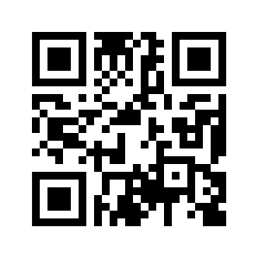
Alex Bender
Alex.Bender@advocacyLeadership.com
https://advocacyleadership.com/

Slide 14
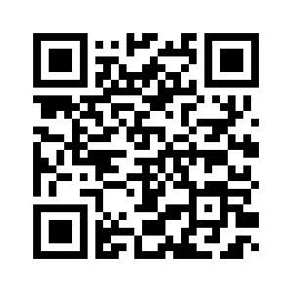
Appendix
https://imagoworks.com/the-imago-dialogue/steps/

